Slide 2

Being human in the digital world is about building a digital world for humans.
-Andrew Keen
British-American entrepreneur and author

Slide 3



Key Highlights
UMS is used by over 30000 students and their parents, and 4500+ staff members.
UMS leads IT initiatives to make LPU one of the country's top IT-enabled universities, catering to in-house and industry software and networking infrastructure demands.
University Management System (UMS) is a proprietary solution and a smart home-grown web-based system with every feature imaginable.

Slide 4



Recognitions & Awards
Shiksha Ratan
Nasscom
E- India

Slide 5
Relationship Management System
Academics Services
Student Support
A tool used by students to communicate with different departments.
Assist students to utilize UMS features to exercise various academic activities.
How UMS supports the students in dealing with miscellaneous functions.
Students
Staff
Assist the staff to exercise their regular academic research activities.
Ensures staff to effectively carry out their administrative duties with ease.
A tool used by staff members to resolve students’ queries/requests and interdepartmental communication.
E-Governance
Overview

Slide 6



Students
Academics Services
Student Support
Services

Slide 7






Polling
LMS
Library Services
Examination
Academics
Feedbacks
Dissertation/Capstone

Slide 8

Learning Management System

Slide 9

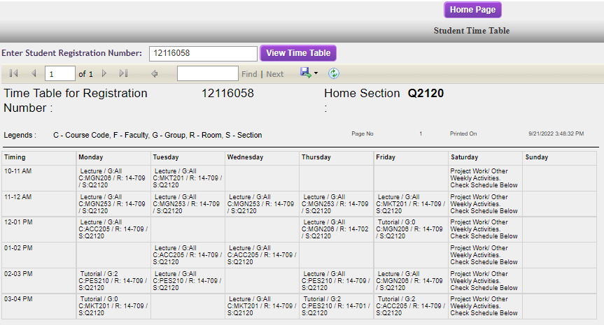
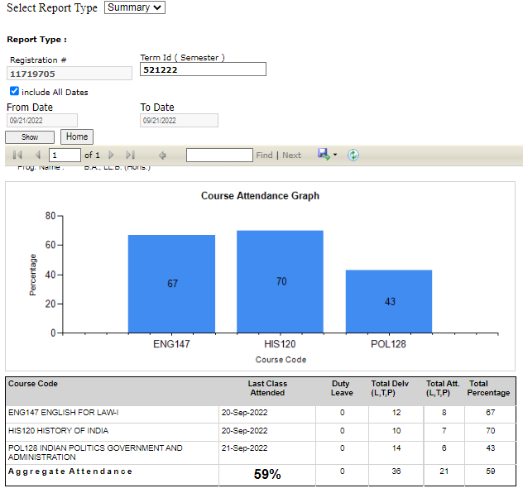
Timetable & Attendance
Students can see their academic attendance and keep a track of it.
Students can find the classes schedule

Slide 10
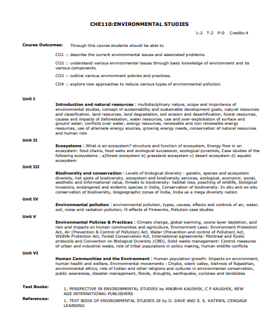
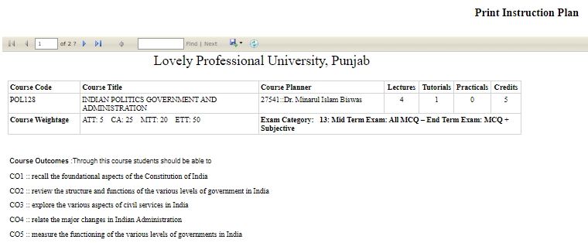
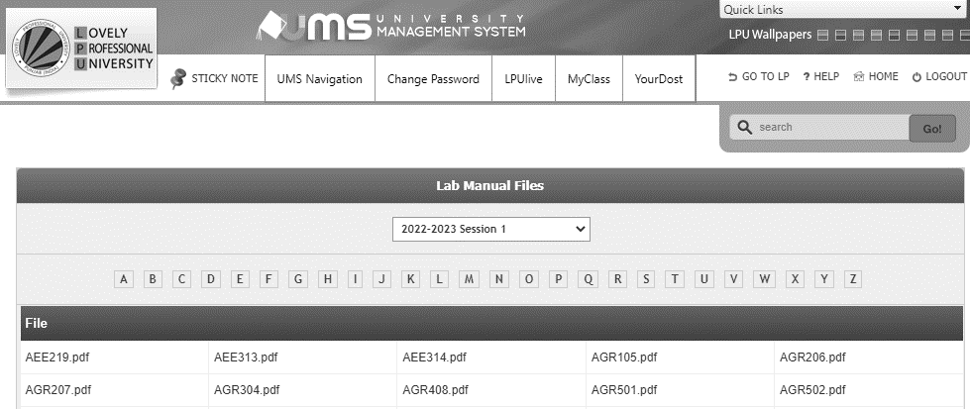
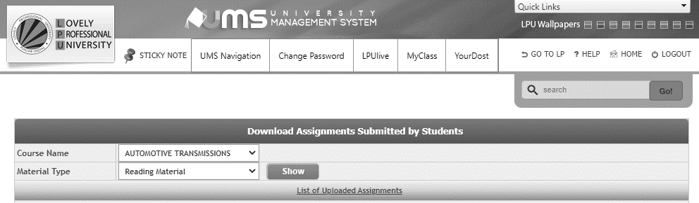
Learning Assistance
Instruction Plan
Lab Manuals
Reading Material
Syllabus

Slide 11
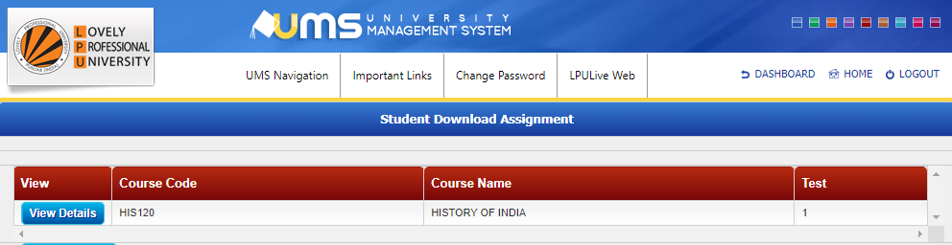
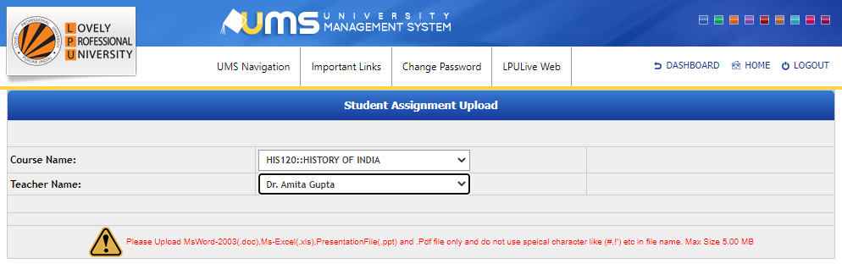
Continuous Assessment
Students can:
download the allocated assignment,
upload the completed assignment, and
check the marks they are awarded for the assignment on UMS thus, eliminating the paperwork involved in it.

Slide 12

Examination

Slide 13
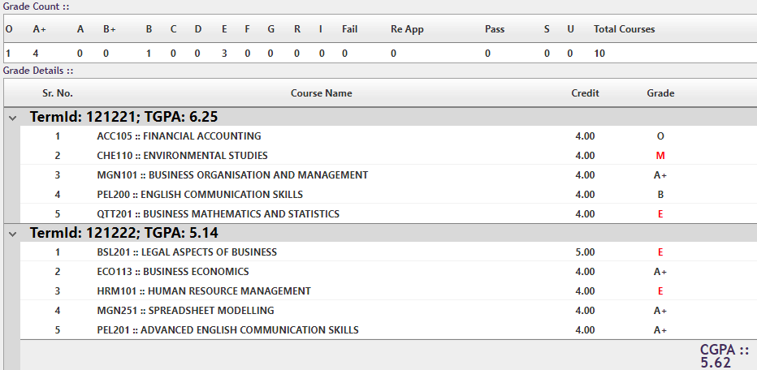
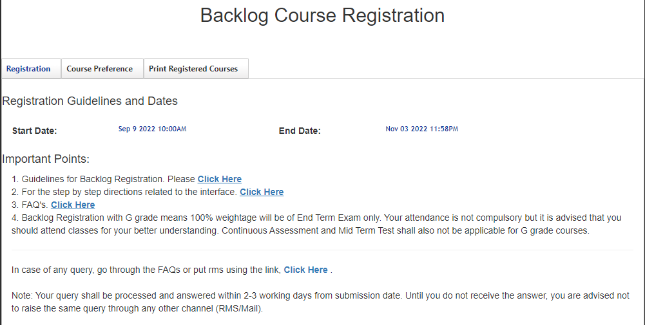
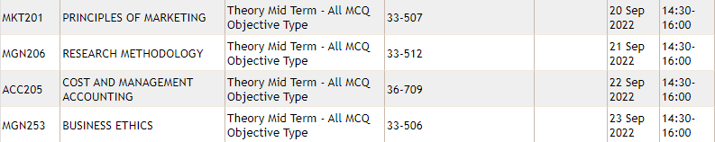

Examination
Result
Backlog/Re-appear Registration
Scrutiny
Seating Plan

Slide 14

Dissertation/Capstone/Training

Slide 15
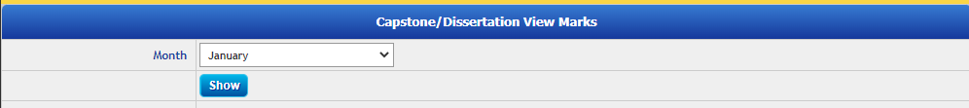
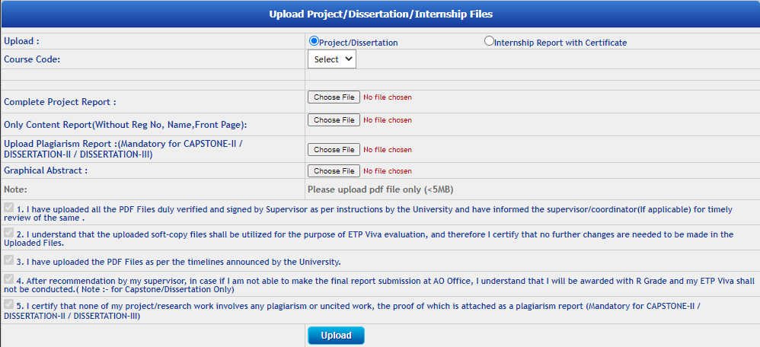
Dissertation/Capstone/Training
Students can:
check the supervisor details and participate in supervisor polling.
view the CA marks awarded by their supervisor.
upload the project or thesis documents.
additionally, upload the record of their publication data, and request for IPR.
Viewing Monthly CA Marks
Uploading Project/Thesis Documents

Slide 16

Feedbacks

Slide 17
Feedbacks
Alumni Feedback on program PO/PSO
Students are made available to provide different types of feedback for continuous improvement in several areas. On UMS following feedback are available:
Curriculum Feedback
Guest Lecture Feedback
Lecture Feedback
Student Exit Survey

Slide 18

Library Services

Slide 19
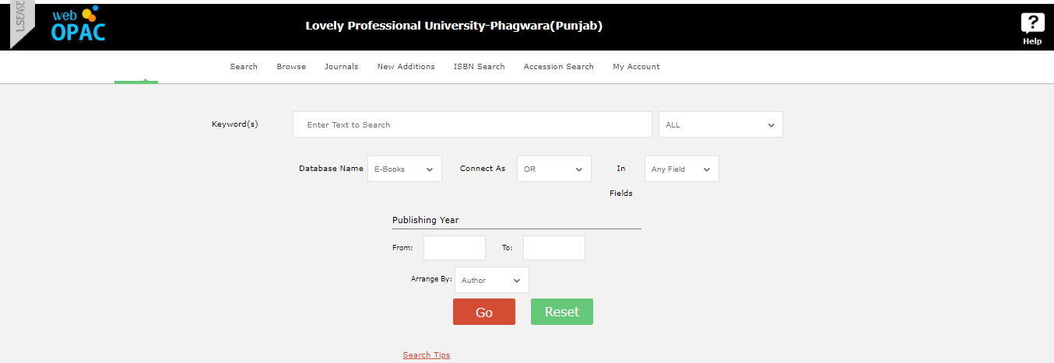
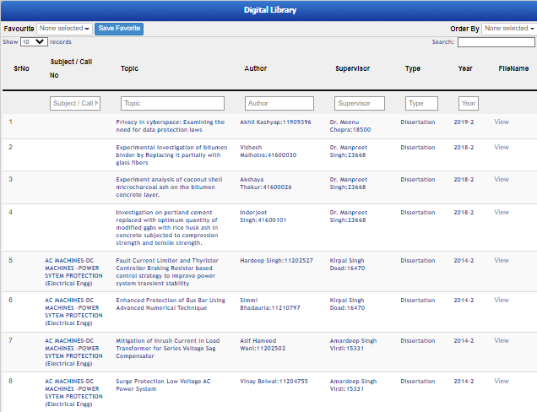
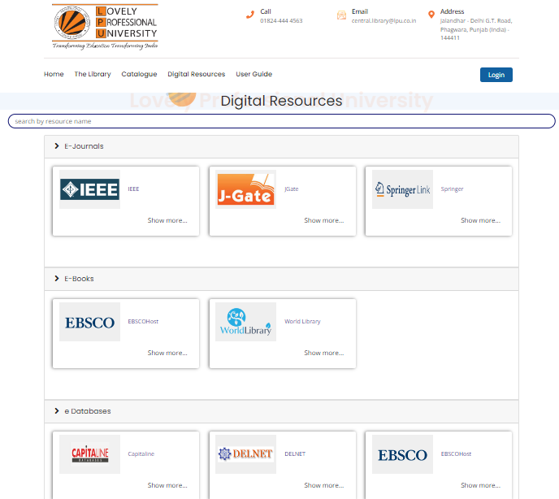
Library Services
Library Search
Students can look for the availability of the books they want on UMS
Thesis Repository
Library Search
University maintains a digital repository of the thesis submitted earlier.
E-Resources
University provides access to several e-resources available to ease the research work for students.
Thesis Repository
E-Resources

Slide 20

Polling

Slide 21
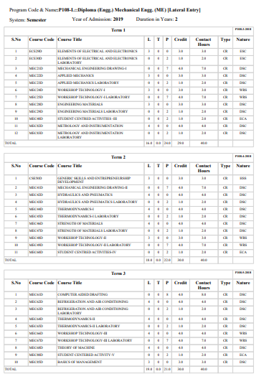

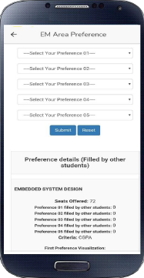

Polling
In the program scheme, a student has a set number of elective courses. We provide them with a basket of elective courses based on the program scheme, and the student selects one of the course from the basket by online polling via UMS.
Program Scheme
Polling on UMS
Elective Basket
Courses

Slide 22






Student Support Services
Accounts
Assistance
Residential Services
Counselling & Health Services
Training & Placement
Records
Student Welfare Services

Slide 23
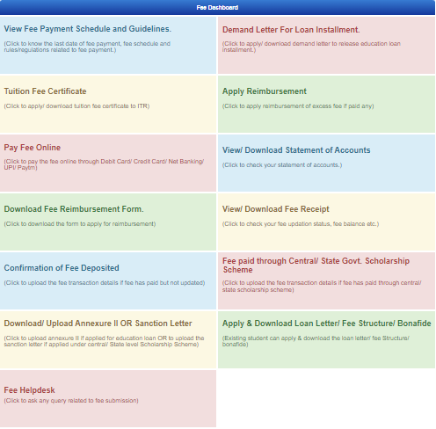
Accounts
Students can use the following menu available for accounts-related functions:
Fee Payment
View Fee Receipt
Demand Letter/Fee Related Certificates
Fee Helpdesk
Processing of Various Scholarship Documents
Fee Dashboard

Slide 24

Residential Services
Students can access the following services associated with the residential department.
Online Residential Booking
Hostel Leave Application
Hostel Change Request
Resident Details (for Day Scholars)
Transport Preference
Vendor Service Search

Slide 25
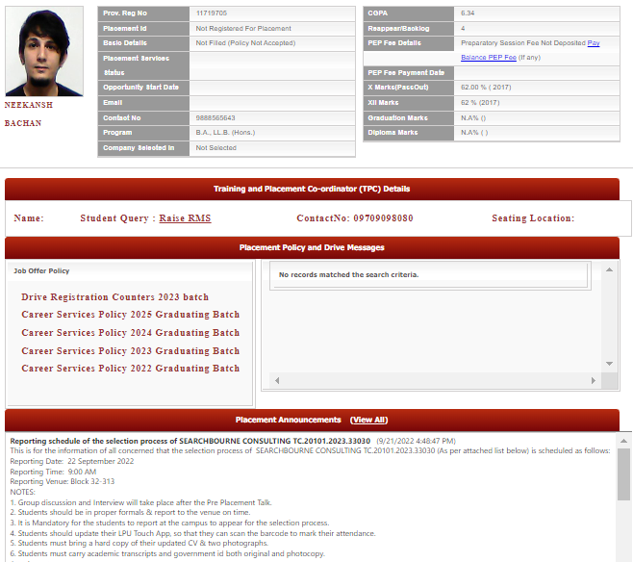
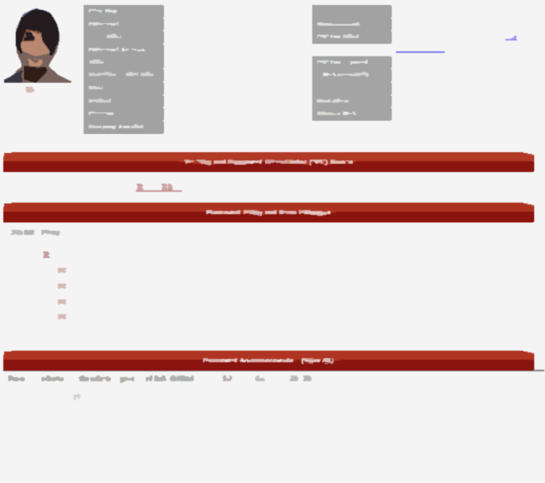


Training & Placement Services
Students can find all the important training & placement-related notifications.
Students can register to the relevant placement drives on the placement dashboard.
Placement Dashboard

Slide 26
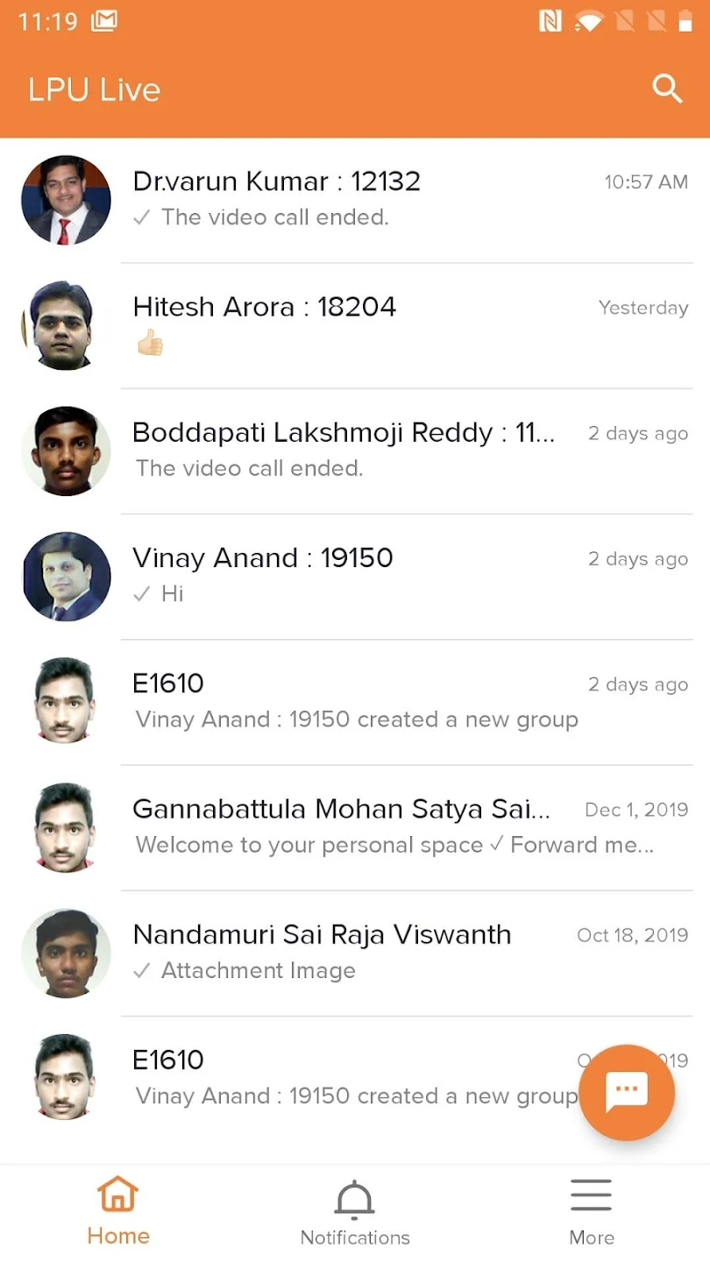
Assistance
Students can book appointments with their mentor/HOD/HOS for redressal of their concerns.
University also has the LPU Live app which is an all-purpose chat app that empowers communication, collaboration, and engagement all on a single platform.

Slide 27
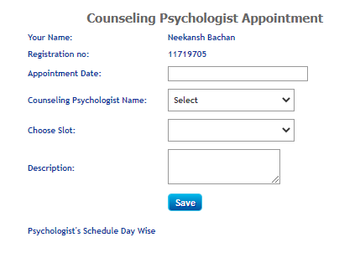
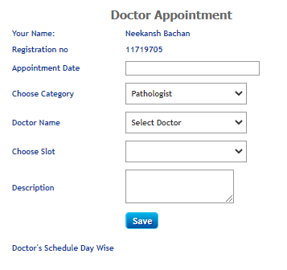


Counselling & Health Services
Students can book confidential and free counseling appointments with psychologists at UMS.
University also has a tie-up with “Your Dost” an emotional wellness solution
Students can book doctor’s appointments at UMS.
Staff

Slide 28
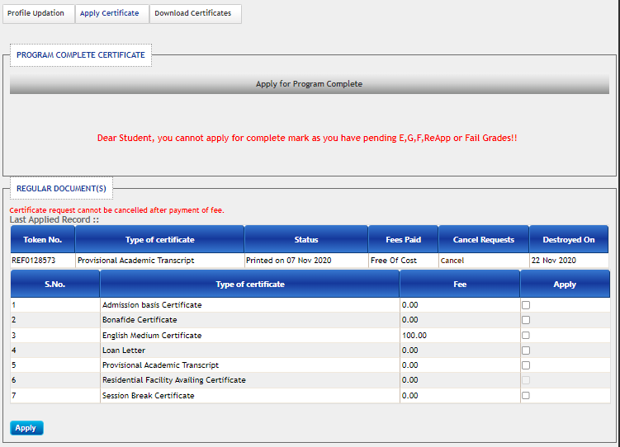
Records
Students can request the following certificates on UMS.
Program Complete Certificate
Scholarship Status
Bonafide Certificate
English Medium Certificate
Loan Letter
Provisional Academic Transcript
Residential Facility Availing Certificate
Session Break Certificate

Slide 29
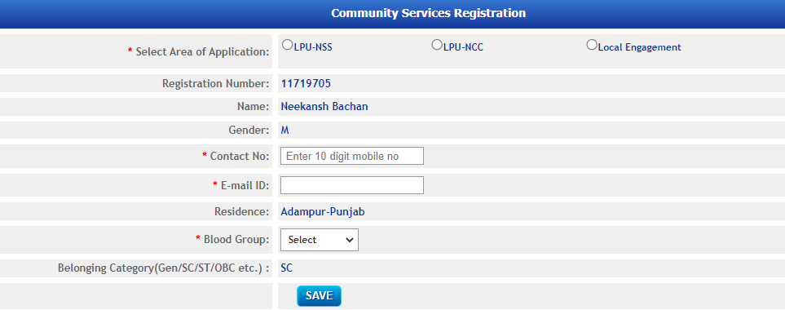
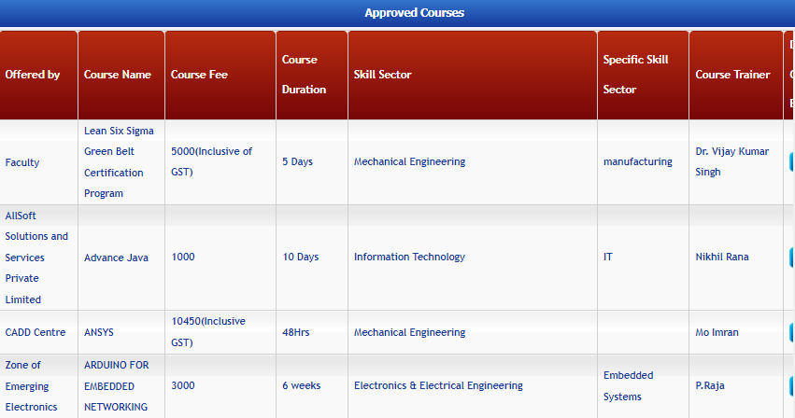
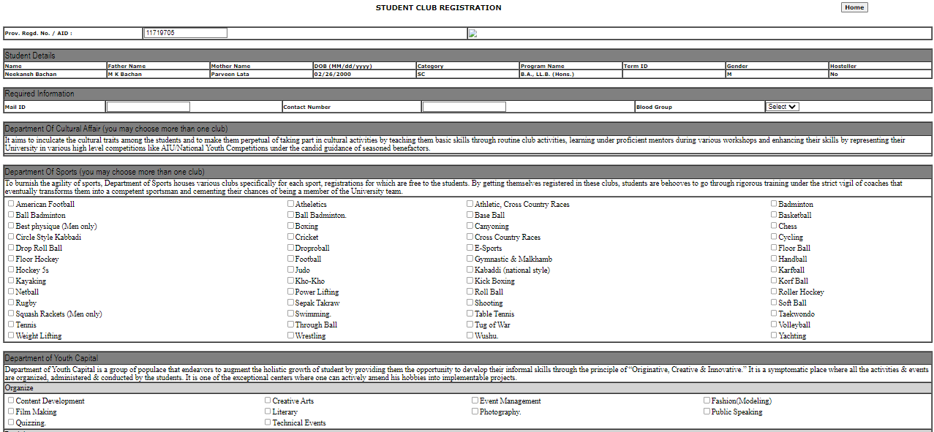
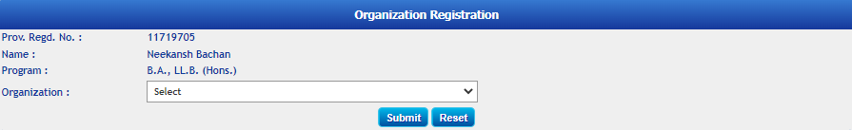
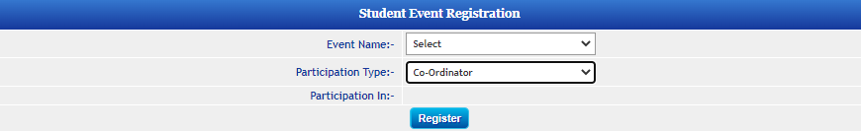
Academics
Student Welfare Services
Research
Community Service Registration
Skill Enhancement Course Registration
E-Governance
Organization Registration
Student Club Registration
Student Event Registration

Slide 30

Staff
Academics
Research
E-Governance

Slide 31
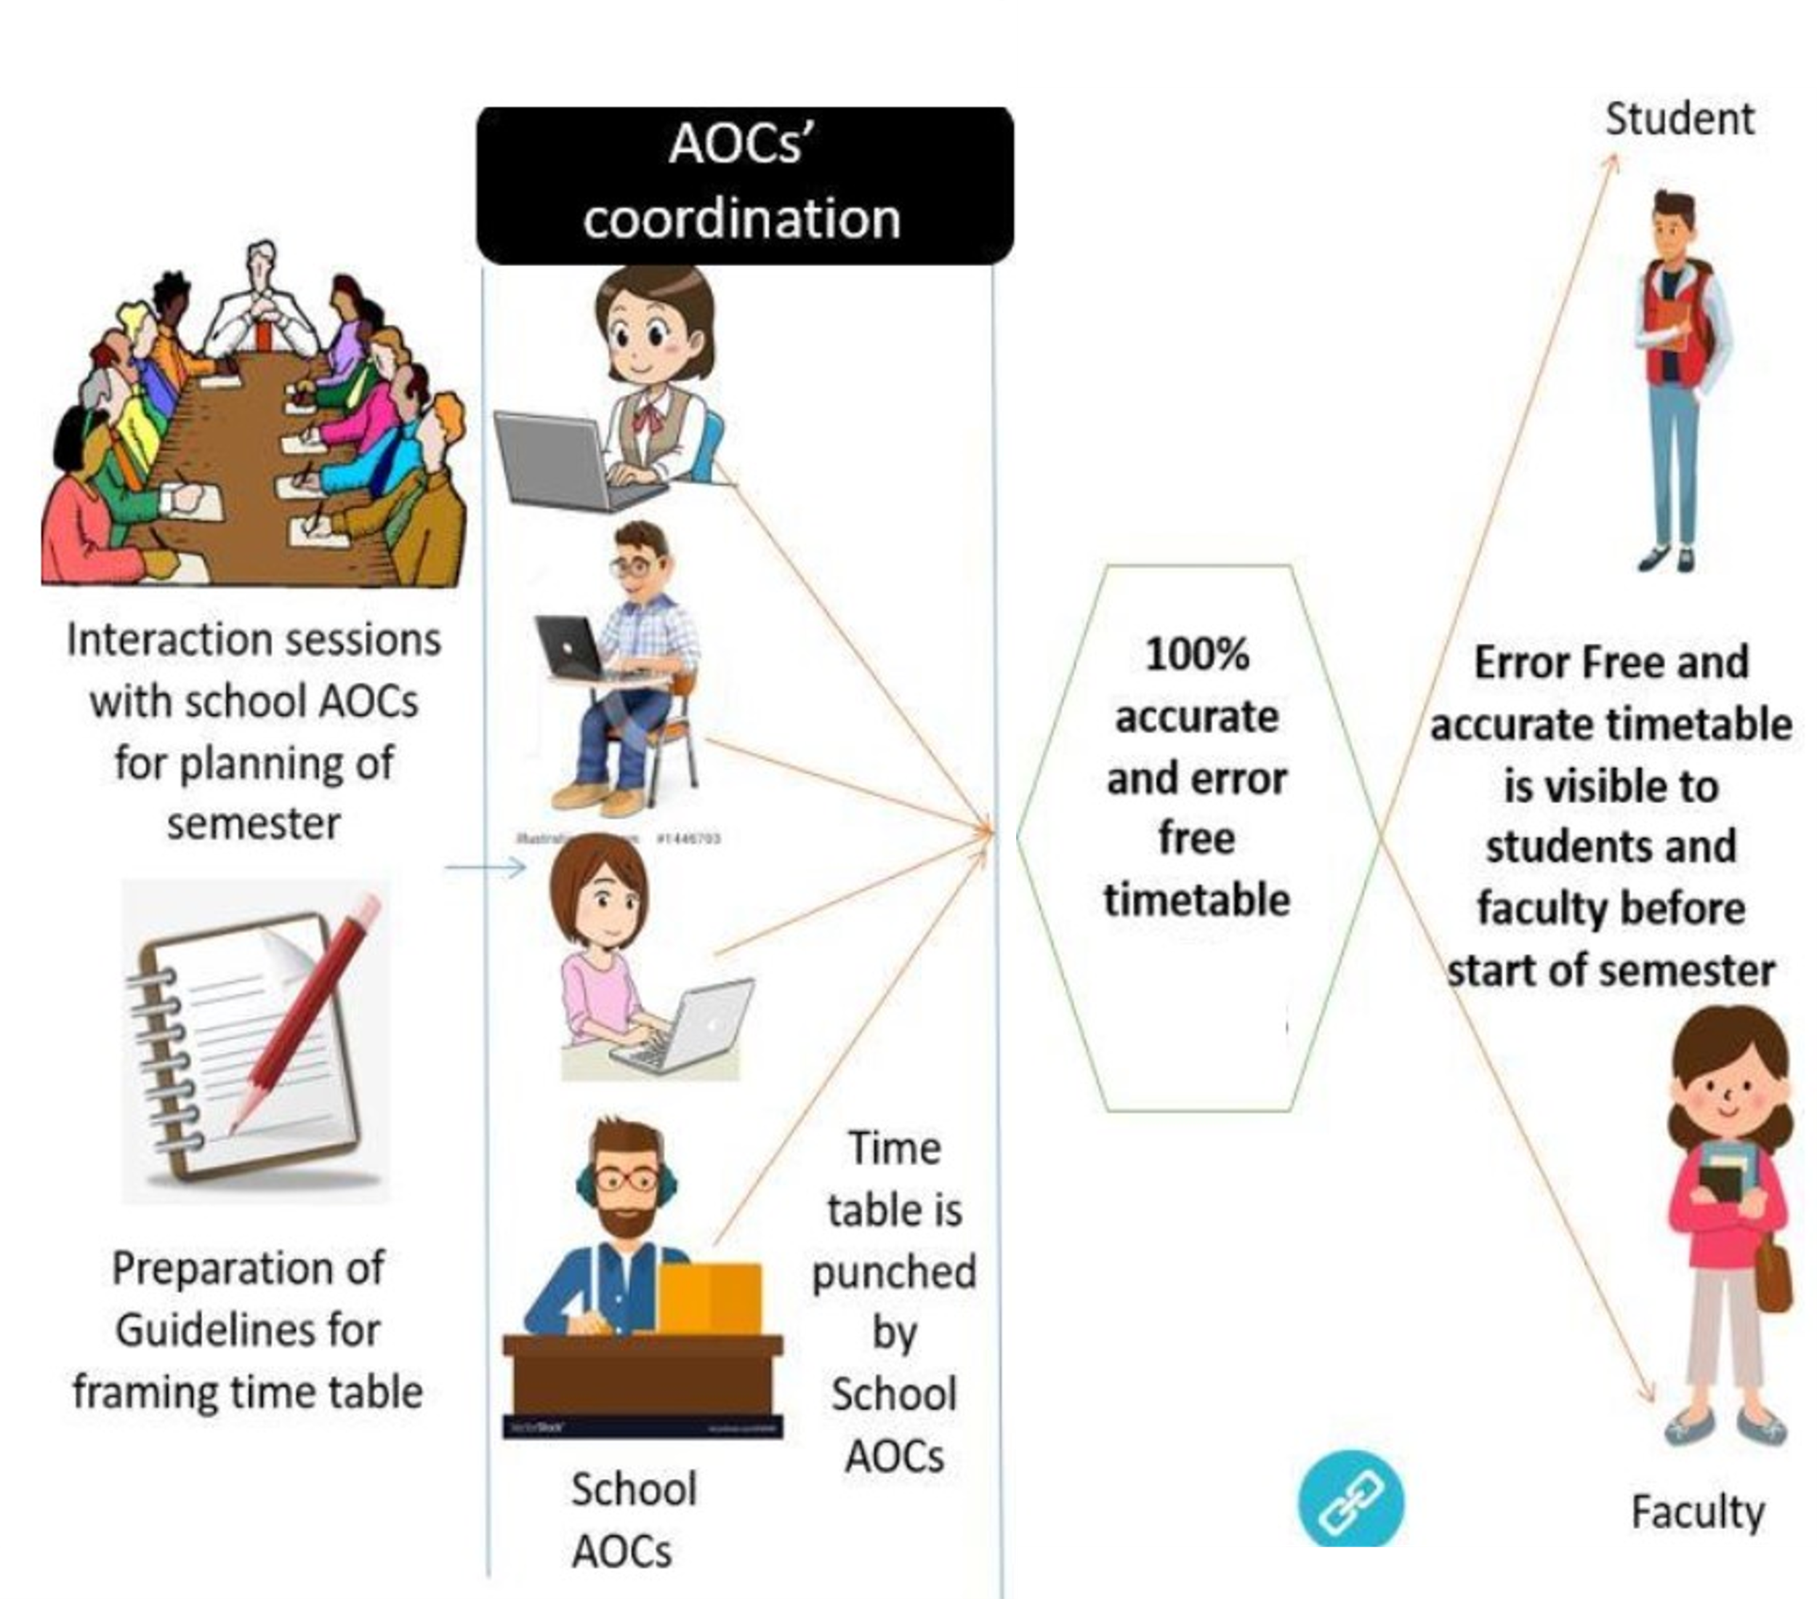
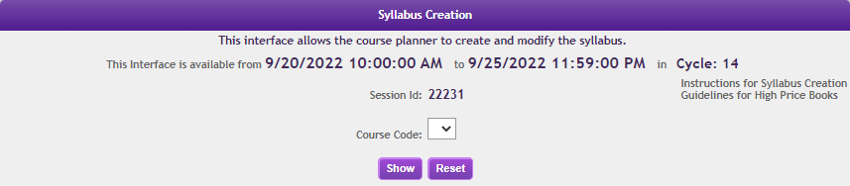
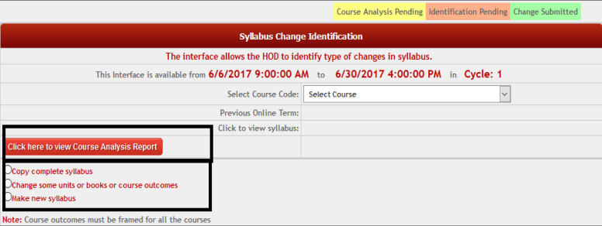
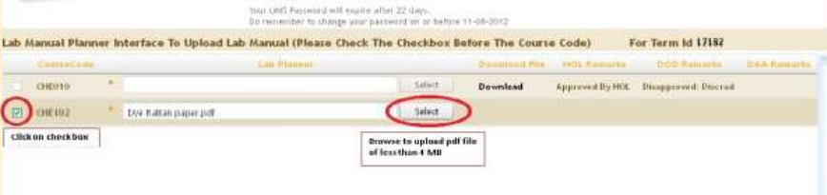
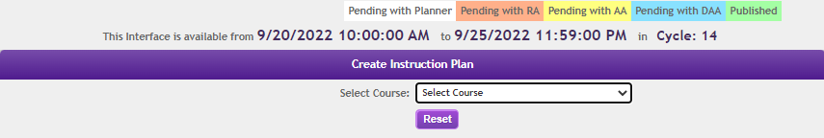
Academics
Preparing and Publishing Syllabi, Instruction Plans, and Lab Manuals
Preparing the school’s timetable for faculty and students
Syllabus Creation
Syllabus Change Identification
Lab Manual Entry Interface
Course’s Instruction Plan Entry

Slide 32




Academics
Preparing and Publishing Syllabi, Instruction Plans, and Lab Manuals
Faculty can perform the following operations on UMS to manage their teaching role with ease.
Preparing the school’s timetable for faculty and students
Syllabus Creation
Giving Individual Student Announcements on UMS.
Syllabus Change Identification
Lab Manual Entry Interface
Assigning and Evaluating Practical Components of the Students
Marking Students’ Attendance During the Class
Course’s Instruction Plan Entry
Allocating, Evaluating, and Viewing Students’ CA Marks

Slide 33


Academics
Faculty can perform the following operations on UMS to manage their teaching role with ease.
Examination Related Activities
For hassle-free conduct of examination in the university following activities are available to be conducted at UMS.
Preparing the school’s timetable for faculty and students
Giving Individual Student Announcements on UMS.
Preparing Question Bank
Assigning and Evaluating Practical Components of the Students
Viewing Examination Duties
Marking Students’ Attendance During the Class
Uploading of MTT, ETE, and ETP Marks
Allocating, Evaluating, and Viewing Students’ CA Marks
Performing Result Analysis

Slide 34
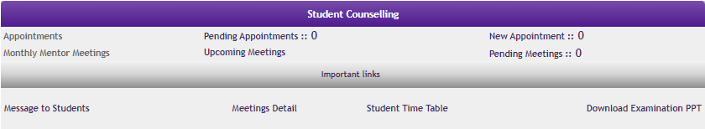
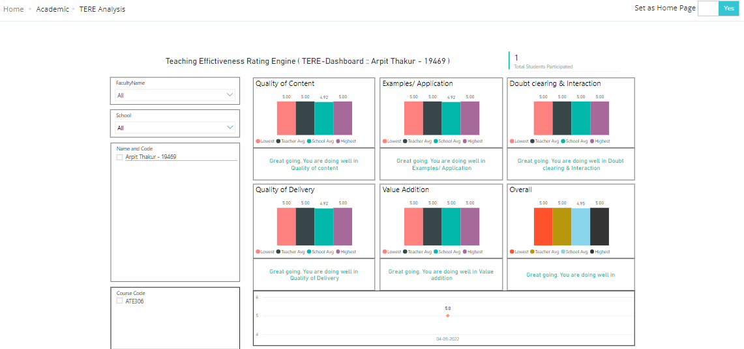
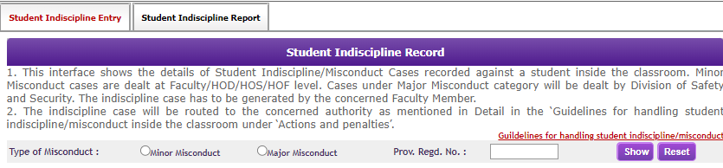
Academics
Examination Related Activities
For hassle-free conduct of examination in the university following activities are available to be conducted at UMS.
Preparing Question Bank
Viewing Examination Duties
Uploading of MTT, ETE, and ETP Marks
Performing Result Analysis

Slide 35
Academics
Examination Related Activities
Student Counselling
Faculty can schedule student counseling sessions at UMS.
For hassle-free conduct of examination in the university following activities are available to be conducted at UMS.
TERE Dashboard
Student Counselling
Teaching Effectiveness Rating Engine can be used by the faculty to see the feedback, students have given on teaching parameters to understand the students’ requirements in class conduct.
Preparing Question Bank
TERE Dashboard
Viewing Examination Duties
Student Indiscipline Record
Uploading of MTT, ETE, and ETP Marks
Faculty can report student indiscipline cases in the classroom.
Performing Result Analysis

Slide 36
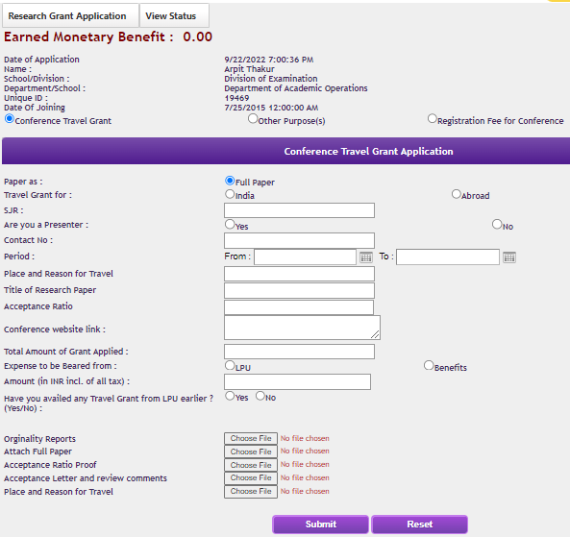
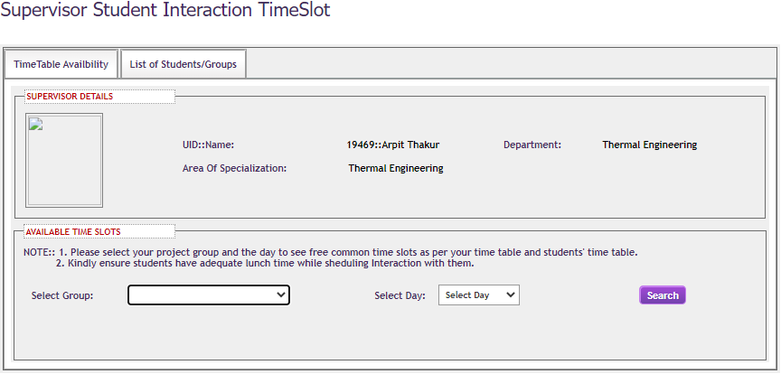
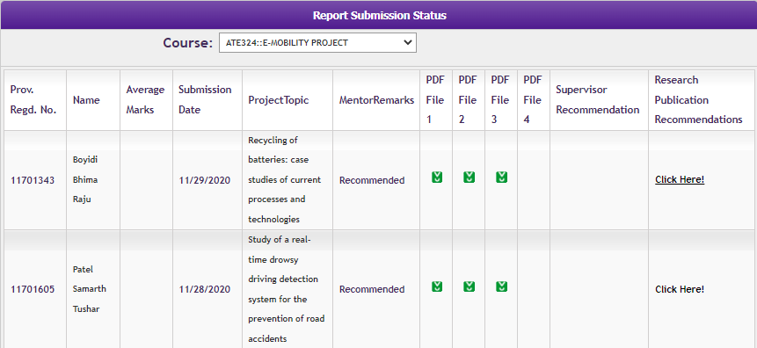
Research
Uploading Monthly CA Marks for Project Work
Applying for Research Grant
Fixing Interaction Slots with Research Scholars
Recommendation of Uploaded Reports

Slide 37
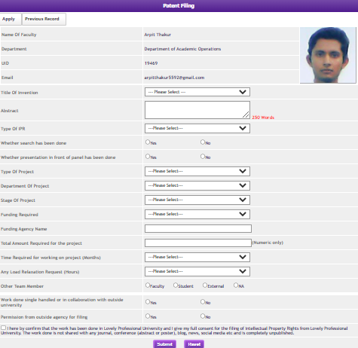
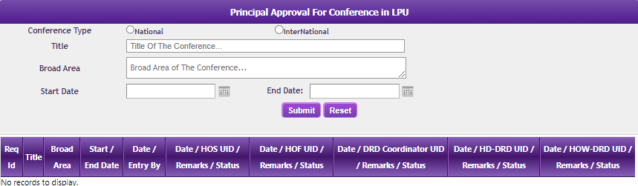

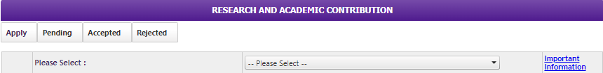
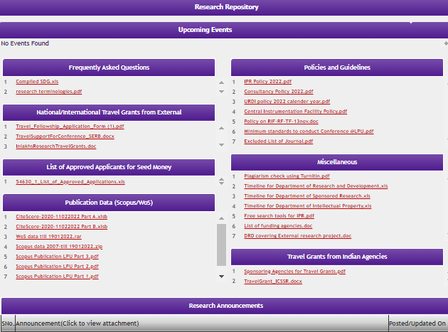
Research
Uploading Monthly CA Marks for Project Work
Applying for IPR
Conference Proposal
Applying for Research Grant
Fixing Interaction Slots with Research Fellows
Recording Research and Academic Contribution
Recommendation of Uploaded Reports
Access to Research Repository

Slide 38
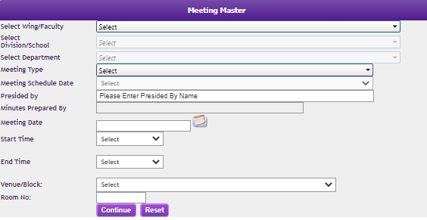
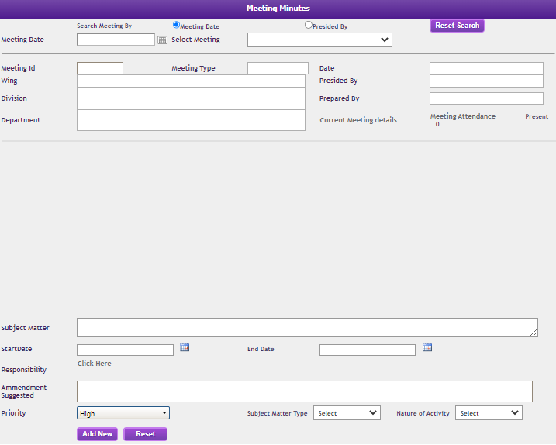
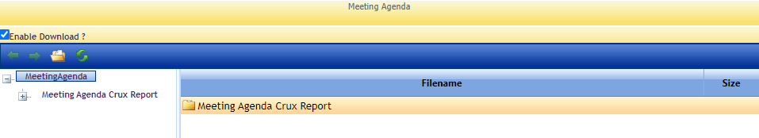
E-Governance
Scheduling Meeting on Meeting Master
Recording Meeting Minutes
Viewing Meeting Agenda

Slide 39
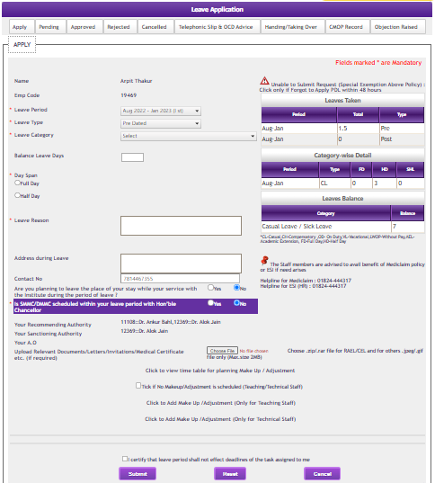
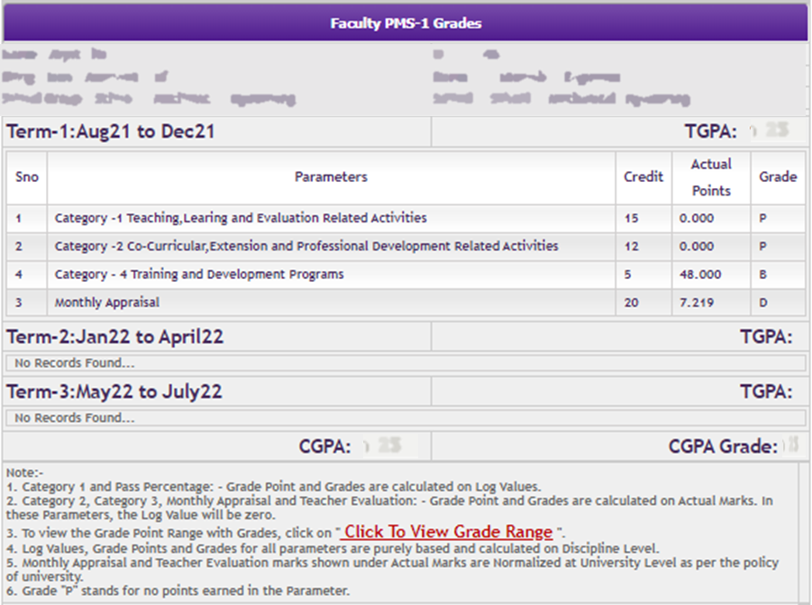

E-Governance
Staff Leave Application
Tracking Faculty Performance through PMS
Accessing HR Policies/Code of Conduct

Slide 40








E-Governance
Applying Service-Related Certificates
Lab Requirement Reporting Engine (LRRE)
Staff Essential Dashboard (Contact Related)
Skill Development Cell (Student Welfare)

Slide 41

E-Governance
Proposal to Conduct Training
Uploading External Training Record
Training Calendar
Accessing Training Resources

Slide 42
E-Governance
Inventory Management System
Feedback
Procurement
Material Requisition
Item receiving/consumption record
Feedback on Curriculum & Pedagogy
Service Satisfaction Survey

Slide 43

Relationship Management System (RMS)
RMS is a grievance redressal system developed to address the pinpointed concerns over any sort of academic and non-academic matters with the relevant department.
Staff or Students can log RMS requests in all the possible categories, these requests will be forwarded to the concerned officials.

Slide 44

Thank You!
Cruising the journey of digital excellence.

